Slide 1

MultiCapCLIP-SAB: Enhanced Visual-Language Grounding
Presented by Saliyah Alotaibi, Supervised by Dr. Muzammil Behzad

Slide 2

The Challenge: Bridging Vision and Language
Recent vision-language models like CLIP align images and text well in zero-shot settings. MultiCapCLIP uses CLIP's visual encoder with an mBART decoder for caption generation.
Limited Grounding
Original MultiCapCLIP uses a simple linear projection, limiting detailed patch-level grounding.
Weakened Attention
The linear bridge weakens the decoder's attention, leading to less precise captions.

Slide 3


Introducing MultiCapCLIP-SAB
We introduce MultiCapCLIP-SAB, an improved architecture that replaces the linear bridge with a Supervised Attention Bridge (SAB).
Compact Transformer
Richer Representations
Frozen Encoders
SAB is a compact multi-layer transformer encoder with learnable query tokens.
Creates more meaningful intermediate representations for better visual-text alignment.
Only the bridge is trained; CLIP and mBART remain frozen.

Slide 4

Key Enhancements of SAB
The Supervised Attention Bridge (SAB) addresses limitations through several key modifications.
Multi-layer Transformer
1
Replaces linear projection with a multi-layer transformer encoder for explicit modeling of visual token dependencies.
Learnable Query Embeddings
2
Functions as semantic anchors, selectively aggregating information from CLIP patch tokens.
Supervised Training
3
Undergoes end-to-end training on annotated image-caption pairs from MSCOCO, enforcing explicit visual-linguistic grounding.

Slide 5
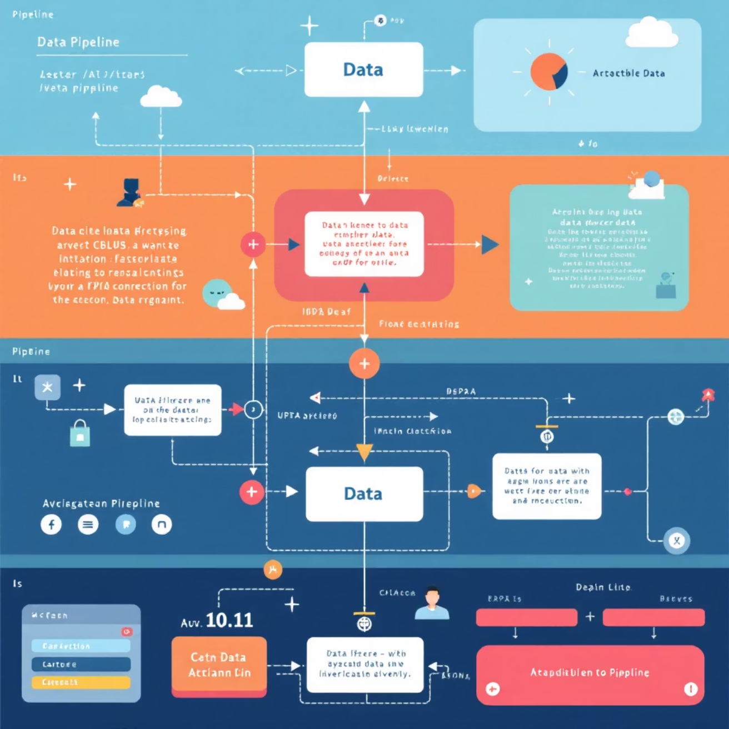
Training Protocol
The training protocol for MultiCapCLIP-SAB optimizes the attention bridge while preserving frozen encoder components.
Data Subset
Curated subset of MSCOCO train2014 with English captions.
Preprocessing
Images resized to 224x224, center cropped, and normalized. Text tokenized with mBART conventions.
Training Epochs
SAB trained for 8-12 epochs with a batch size of 32.
Optimization
AdamW optimizer with learning rate 1e-4, warmup, and gradient clipping.

Slide 6

Loss Function and Optimization
Model training is governed by a cross-entropy loss function, ensuring accurate sequential prediction.
Cross-Entropy Loss
AdamW Optimizer
Maximizes likelihood of ground-truth caption tokens given visual context.
Combined with a linear warmup schedule and cosine annealing decay for robust training.
Stable Convergence
Warmup prevents destabilization; cosine decay reduces learning rate for stable optimum.

Slide 7

Experimental Design & Evaluation
We used two distinct datasets for training and evaluation.
Datasets
Training: Stratified subset of MSCOCO train2014.
Evaluation: Flickr30k test split for zero-shot generalization.
Preprocessing
Images: CLIP normalization standards.
Text: mBART tokenization specifications.

Slide 8

Performance Metrics
Model performance was assessed using established metrics for image captioning.
BLEU Scores (1-4)
Measures precision of n-gram matches, capturing linguistic structures.
METEOR
Incorporates synonymy, stemming, and word order for nuanced semantic assessment.
ROUGE-L
Evaluates longest common subsequence, emphasizing overall structural similarity.

Slide 9
Results & Ablation Study
MultiCapCLIP-SAB shows clear improvements in ROUGE-L and competitive BLEU scores.
BLEU-1
0.473
0.3404
Ablation Insights
Query tokens are essential for detailed descriptions.
BLEU-2
0.285
0.1814
SAB outperforms a plain linear layer, capturing complex relationships.
BLEU-3
0.177
0.0890
Sufficient training epochs are crucial for stable cross-modal mapping.
BLEU-4
0.110
0.0394
METEOR
0.139
0.2030
Deeper SAB yields better-grounded captions, with increased computational cost.
ROUGE-L
0.307
0.2669
CIDEr
0.167
0.0526
BLEU scores decline due to limited training data, while METEOR improves significantly, reflecting stronger semantic grounding. ROUGE-L also shows structural gains.

Slide 10





Conclusion & Future Work
MultiCapCLIP-SAB enhances zero-shot multilingual image captioning through a Supervised Attention Bridge.
Multilingual Data
Expand Training
Incorporate multilingual caption data for cross-lingual transfer.
Utilize full MSCOCO dataset for richer supervision signals.
Architectural Refinements
Investigate deeper attention architectures and alternative mechanisms.
Broader Applications
Apply supervised bridging to other vision-language tasks.
Explicit Grounding
Explore objectives beyond cross-entropy loss for finer granularity.

